Slide 1
Introduction to Data Analysis

Slide 2
DATA VISUALIZATION BASICS
Patrick Boily Data Action Lab | uOttawa | Idlewyld Analytics
pboily@uottawa.ca
[with files from Stephen Davies | DAVHILL]

Slide 3
“Discovery is no longer limited by the collection and processing of data, but rather management, analysis, and visualization.”
@DamianMingle

Slide 4
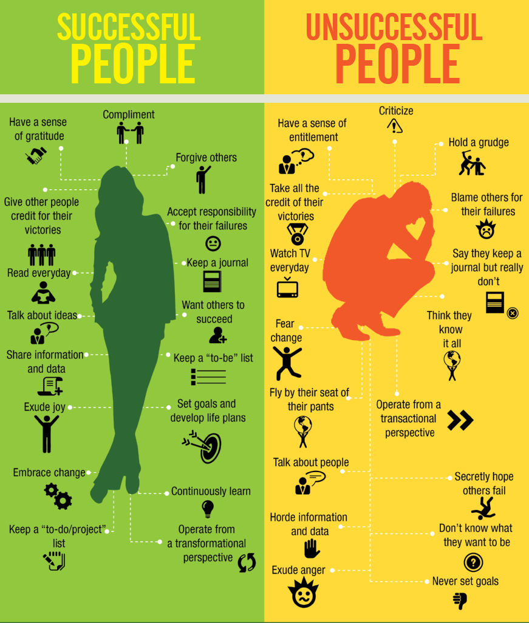
INFOGRAPHICS
[J.P. Blackard]
Created for story-telling purposes (subjective)
Intended for a specific audience
Self-contained and discrete
Graphic design aspect is key
Cannot usually be re-used with other data
Can incorporate unquantifiable information

Slide 5
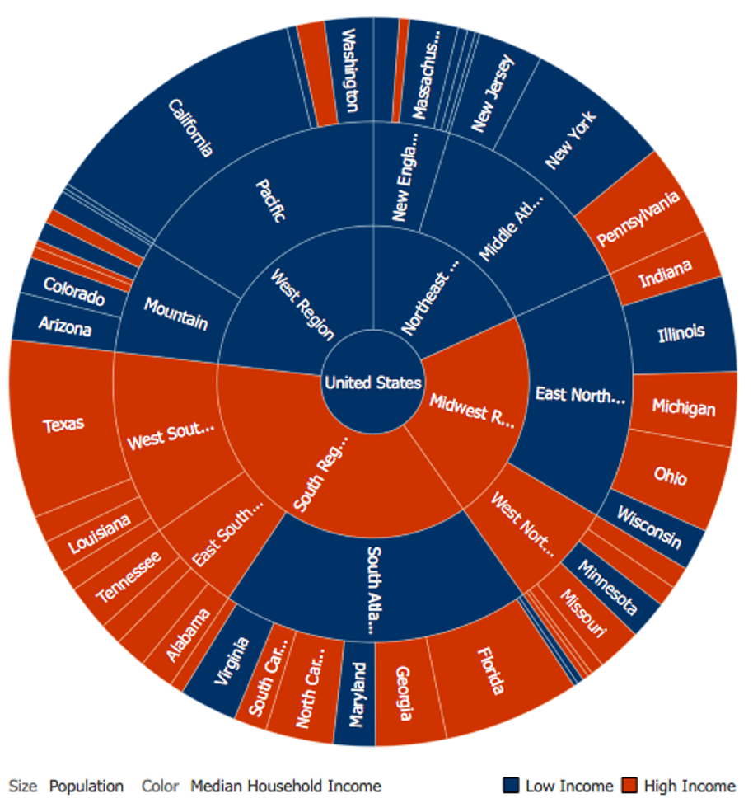
DATA VISUALIZATION
[Author unknown]
A method, as well as an item (objective)
Typically focuses on the quantifiable
Used to make sense of the data or to make it accessible (datasets can be massive and unwieldy)
May be generated automatically
The look and feel are less important than the insights conveyed by the data

Slide 6
THE (MESSY) ANALYSIS PROCESS
Objective/
Rationale
Utilization and Decision Support
Data Collection
Data Exploration
Infrastructure and Data Management
Data Preparation
Modeling and Analysis
Communication

Slide 7
PRE-ANALYSIS DATA VISUALIZATION
DATA VISUALIZATION BASICS

Slide 8
SOME BASIC QUESTIONS
What system does your data represent – objects, attributes, relationships?
How does it represent this system – i.e. the data model?
Who made this dataset? When? For what purpose?
Assuming a flat file – what do the rows represent? What do the columns represent?
Do you even have enough information (e.g. metadata) to answer these questions? Where can you find more information?

Slide 9
PRE-ANALYSIS USE
Data visualization can be used to set the stage for analysis:
detecting anomalous entries invalid entries, missing values, outliers
shaping the data transformations binning, standardization, Box-Cox transformations, PCA-like transformations
getting a sense for the data data analysis as an art form, exploratory analysis
identifying hidden data structure clustering, associations, patterns informing the next stage of analysis

Slide 10
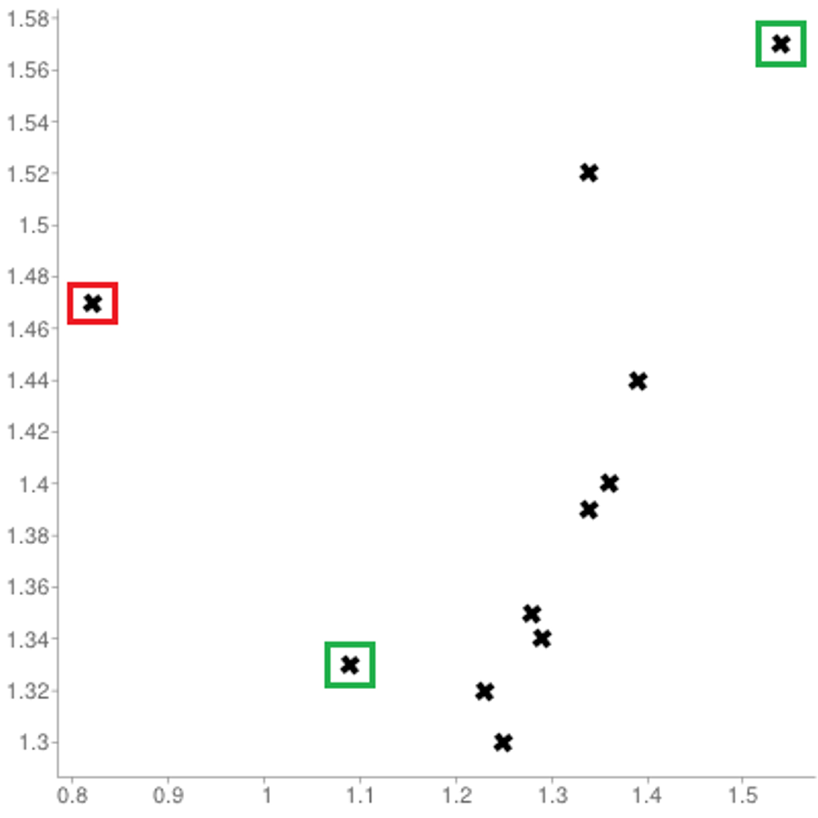
[Personal dataset]
Customers served at counter (per minute)
Customer arrivals at counter (per minute)

Slide 11
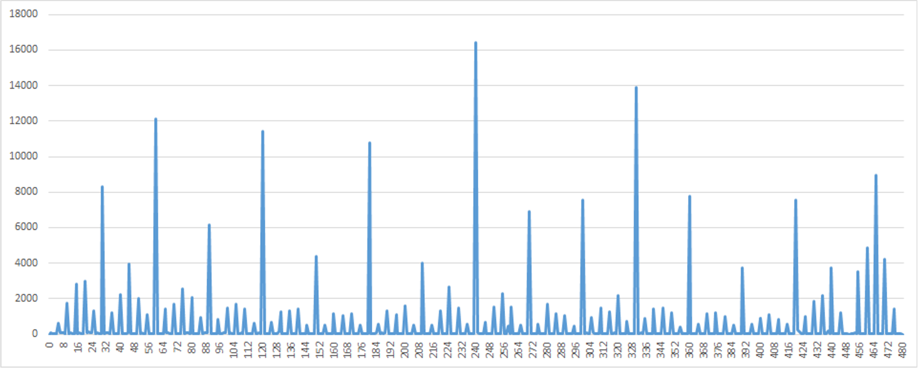
[Personal dataset]
Self-reported work hours (mins)

Slide 12
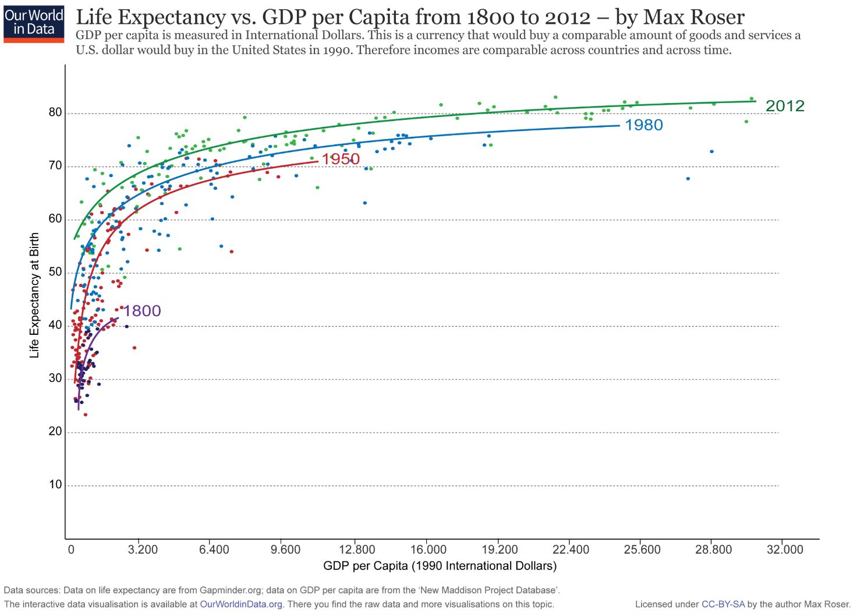
[https://ourworldindata.org/life-expectancy]
This graph displays the correlation between life expectancy and GDP per capita.
Countries with higher GDP have, in general, a higher life expectancy.
The relationship seems to follow a logarithmic trend: the unit increase in life expectancy per unit increase in GDP decreases as GDP per capita increases.

Slide 13
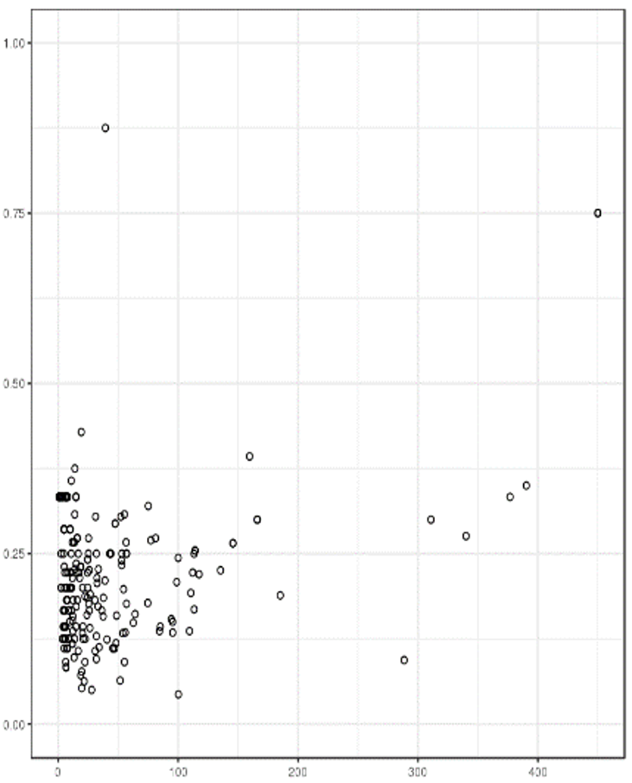
REPRESENTING OBSERVATIONS
[http://promise.site.uottawa.ca/SERepository/datasets/cm1.arff]
NASA CM1 Dataset (subset)
2 variables can be represented by position in the plane.
Additional factors can be depicted through:
size
color
value
texture
line orientation
shape
(motion?)
NASA CM1 Dataset (subset)

Slide 14
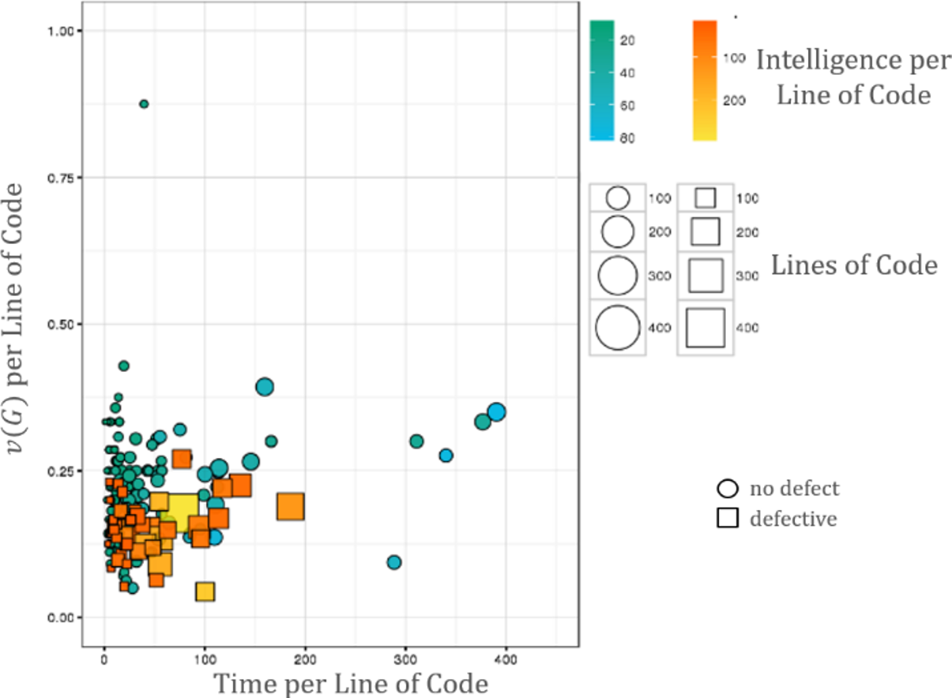
[http://promise.site.uottawa.ca/SERepository/datasets/cm1.arff]
NASA CM1 Dataset (subset)
colour
size
shape
position

Slide 15
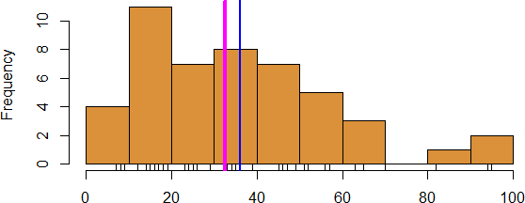
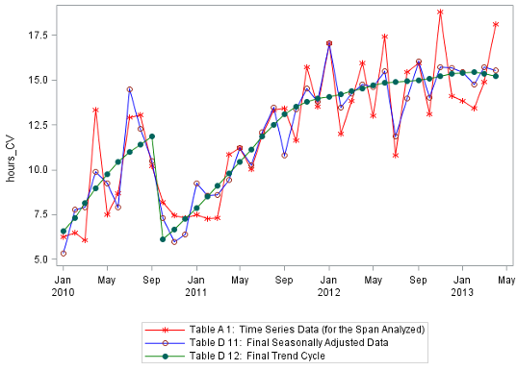
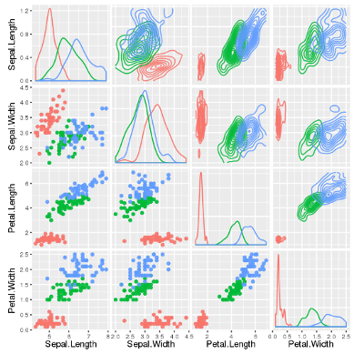
WORKHORSE VISUALIZATIONS
Line Chart/Rug Chart/Number Line
Histogram
Line Graph
Boxplot
Bar Chart
Scatterplot

Slide 16
POST-ANALYSIS DATA VISUALIZATION
DATA VISUALIZATION BASICS

Slide 17
FUNDAMENTAL PRINCIPLES OF ANALYTICAL DESIGN
[E. Tufte, Beautiful Evidence]
Reasoning and communicating our thoughts are intertwined with our lives in a causal and dynamic multivariate Universe.
Symmetry to visual displays of evidence: consumers should be seeking exactly what producers should be providing, namely
meaningful comparisons
causal networks and underlying structure
multivariate links
integrated and relevant data
honest documentation
primary focus on content

Slide 18
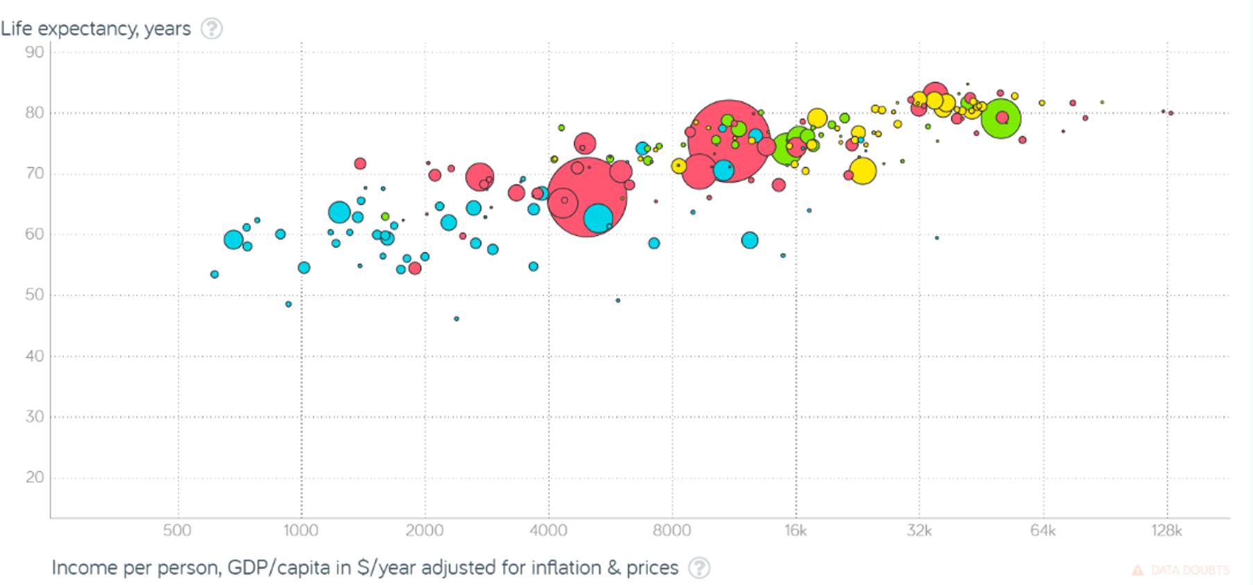
[Gapminder Foundation]
Non-Integrated Data

Slide 19
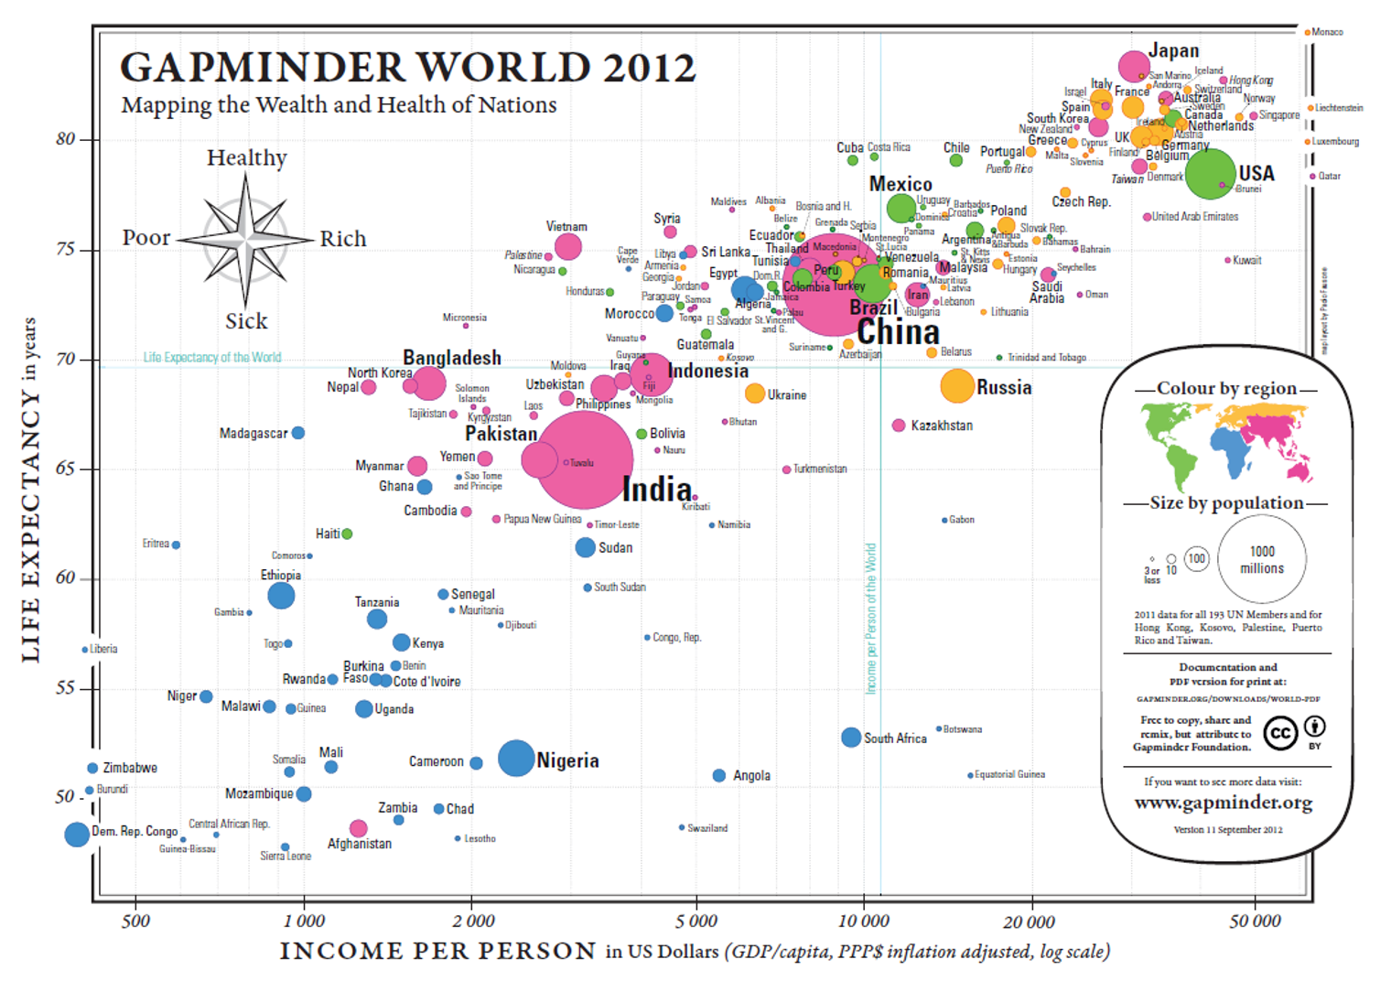
[Gapminder Foundation, https://www.ted.com/talks/hans_rosling_shows_the_best_stats_you_ve_ever_seen]

Slide 20
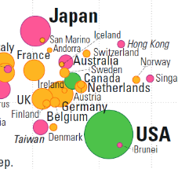
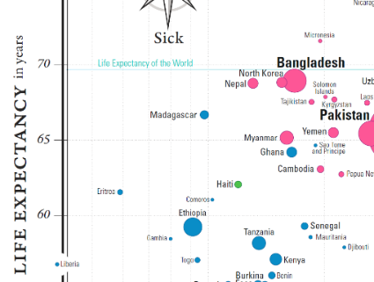
[Gapminder Foundation, https://www.ted.com/talks/hans_rosling_shows_the_best_stats_you_ve_ever_seen]
Meaningful Comparisons

Slide 21
[Gapminder Foundation, https://www.ted.com/talks/hans_rosling_shows_the_best_stats_you_ve_ever_seen]
Underlying Structure and Multivariate Links

Slide 22
[Gapminder Foundation, https://www.ted.com/talks/hans_rosling_shows_the_best_stats_you_ve_ever_seen]
Underlying Structure and Multivariate Links
Underlying Structure and Multivariate Links

Slide 23
[Gapminder Foundation, https://www.ted.com/talks/hans_rosling_shows_the_best_stats_you_ve_ever_seen]
Underlying Structure and Multivariate Links
Underlying Structure and Multivariate Links

Slide 24
[Gapminder Foundation, https://www.ted.com/talks/hans_rosling_shows_the_best_stats_you_ve_ever_seen]
Documentation

Slide 25
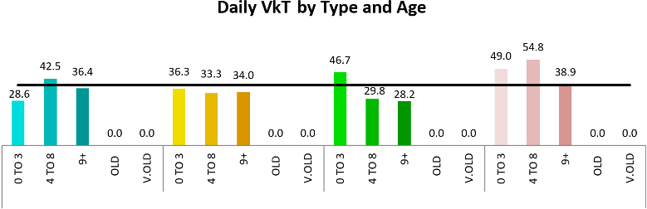
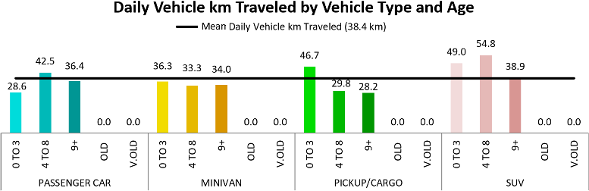
BASIC RULES
[http://flowingdata.com/tag/pitfalls]
1. Check the data outliers, spikes, anomalies
2. Explain encoding don't assume the reader knows what everything means
3. Label axes knowing the scale is important

Slide 26

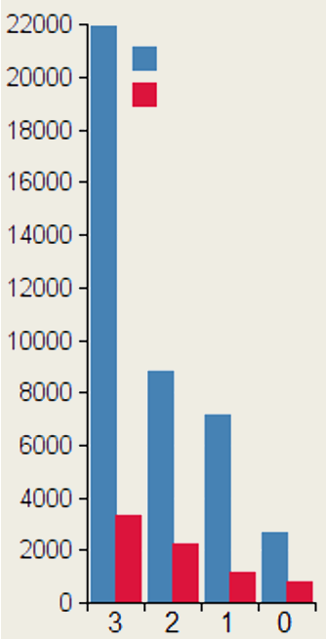
BASIC RULES
[http://flowingdata.com/tag/pitfalls]
Cancer cases
3.5 radius
Incidence
4. Include units eliminate the need for guesswork
5. Keep your geometry in check circles and 2D shape are sized by area, bar charts by length
6. Include your sources protect yourself, and let those who want to dig deeper do so
7. Consider your audience a poster can be wordy, a presentation should be minimalist
Mortality
3.5 area
Eggplant consumption, per week

Slide 27
PRESENTING ANALYSIS RESULTS
Graphics should be clear and engaging.
Not every pretty picture tells a story, but if a story can't be told with pretty pictures, perhaps it’s time to re-think the story…
Graphical representation techniques appear regularly – it’s too early to tell which ones will stand the test of time.
Don’t be afraid to try something new if it helps convey the message.

Slide 28
A WORD ABOUT ACCESSIBILITY
[http://dataphys.org/list/]
Charts cannot usually be translated to Braille. Describing the features and emerging structures in a visualization is a possible solution… if they can be spotted.
Analysts must produce clear and meaningful visualizations, but they must also describe them and their features in a fashion that allows all to "see" the insights. This requires analysts to have “seen” all the insights, which is not always possible.
Conditions: colourblindness, low vision, motor impairment, cognitive disability, ADHD, etc.
Best Practices: high contrast text/elements, zoom/magnifications, keyboard navigation, assistive design, short summaries, undo/redo functionality, etc. [F. Elavsky]

Slide 29
A WORD ABOUT ACCESSIBILITY
Data Perception:
texture-based representations
text-to-speech
sound/music
odor-based or taste-based representations (?!?)
Sonifications:
TRAPPIST Sounds : TRAPPIST-1 Planetary System Translated Directly Into Music
Listening to data from the Large Hadron Collider, L. Asquith

Slide 30
TAKE-AWAYS
Is the point getting across? Integrated data helps convey the message.
Adding design elements can enhance our understanding of the data.
How we spot patterns affect what we get out of data presentations.
Data displays are not just about picking a random visualization method. The result varies depending on the structure of the data and the (combinations of) questions.

Slide 31
Visualization Catalogue
DATA VISUALIZATION BASICS

Slide 32
DATA DISPLAYS
With data displays, we try to highlight:
a relationship (show a connection or correlation between two or more variables);
a comparison (set some variables apart from others, and display how those two variables interact);
a composition (collect different types of information that make up a whole and display them together), and
a distribution (lay out a collection of related or unrelated information to see how it correlates, if at all, and to understand if there's any interaction between the variables).

Slide 33
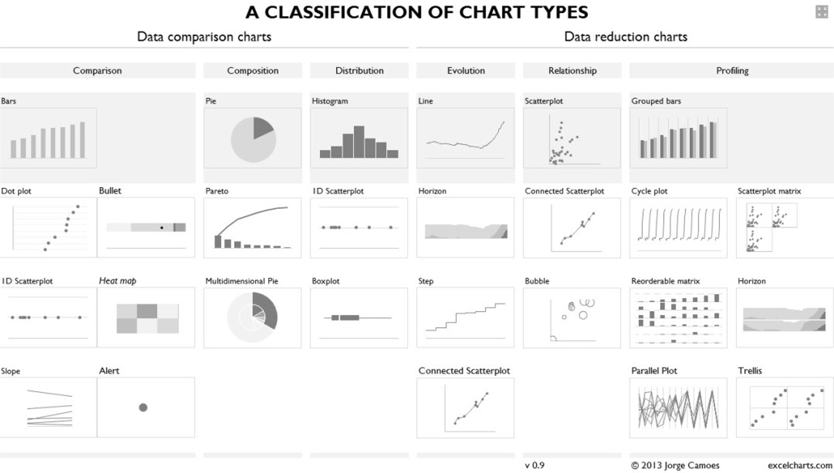

Slide 34
SIMPLE TEXT AND TABLES
One or two numbers to focus on may help “set the scene” and draw focus to an area of the report.
Tables interact with our verbal system (we read them):
used to compare values
audiences will look for their rows
Table design needs to blend into background:
the data should stand out, not the borders
dense table: use alternating row colour
Leverage colour to convey magnitude:
use single colour saturation
use a legend to remove values
95% of the population
drinks tea today compared to
75% in 2007

Slide 35
TABLES AND TABLE HEATMAPS
Name | Last Year | This Year
Ron | 20 | 30
Fred | 30 | 40
George | 10 | 15
Name | Last Year | This Year
Ron | 20 | 30
Fred | 30 | 40
George | 10 | 15

Slide 36
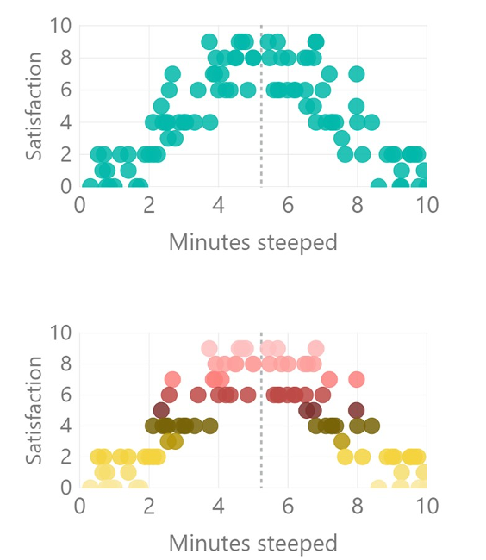
SCATTERPLOTS
How long should the perfect cup of tea be steeped?
Show relationship between 2 variables (scatterplot) or 3 variables (bubble plot):
use average lines (dotted lines) to provide context
far fewer options in Power BI than in R or Excel
consider using groupings to add clarity (e.g. colour gradients)

Slide 37
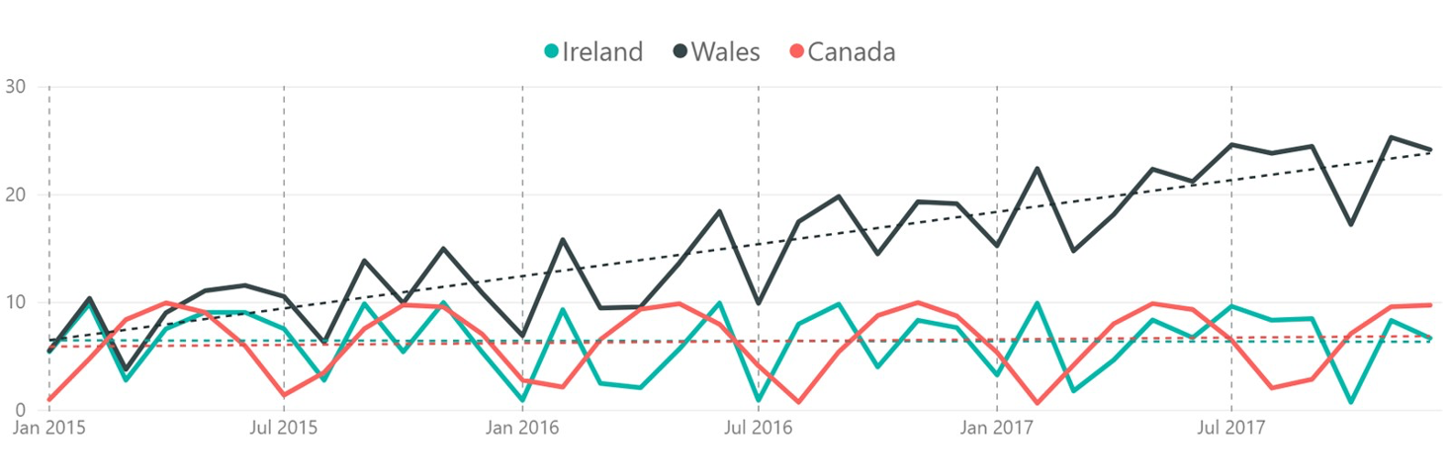
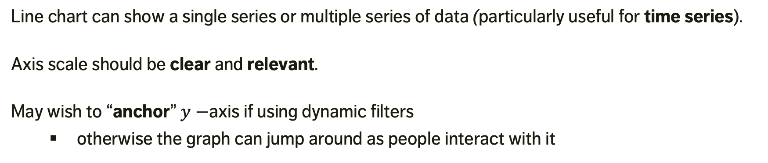
LINE CHARTS
Line chart can show a single series or multiple series of data (particularly useful for time series).
Axis scale should be clear and relevant.
May wish to “anchor” $y−$axis if using dynamic filters
otherwise the graph can jump around as people interact with it
Comparison of Countries – cups of tea drunk per week per person

Slide 38
BAR CHARTS
Versatile and useful.
ALWAYS (?) use a zero baseline.
Use graph axis OR data labels: axis for broad statements, data labels for details.
Horizontal charts are apparently easier to read (according to many studies).
Think about the ordering of categories.

Slide 39
STACKED BAR CHARTS
Designed for comparing totals, but can quickly become overwhelming.
Hard to sort / order.
Filtering is complicated in Power BI (what do you click on & how does the chart responds when the filter is clicked on?).

Slide 40
100% BAR CHARTS
Work well for visualizing portions of a whole on scale from negative to positive.
Consistent baseline on far left and right.
Easy to compare.
Problem: there is no relative measure to magnitude of data (unless labeled).
Again, research shows that horizonal charts are easier to process.

Slide 41
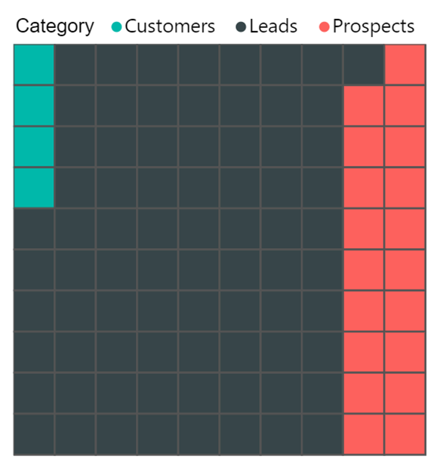
AREA CHARTS
Try to avoid: human brains have a hard time attributing a value to a 2D area…
… except for numbers with vastly different magnitudes.

Slide 42
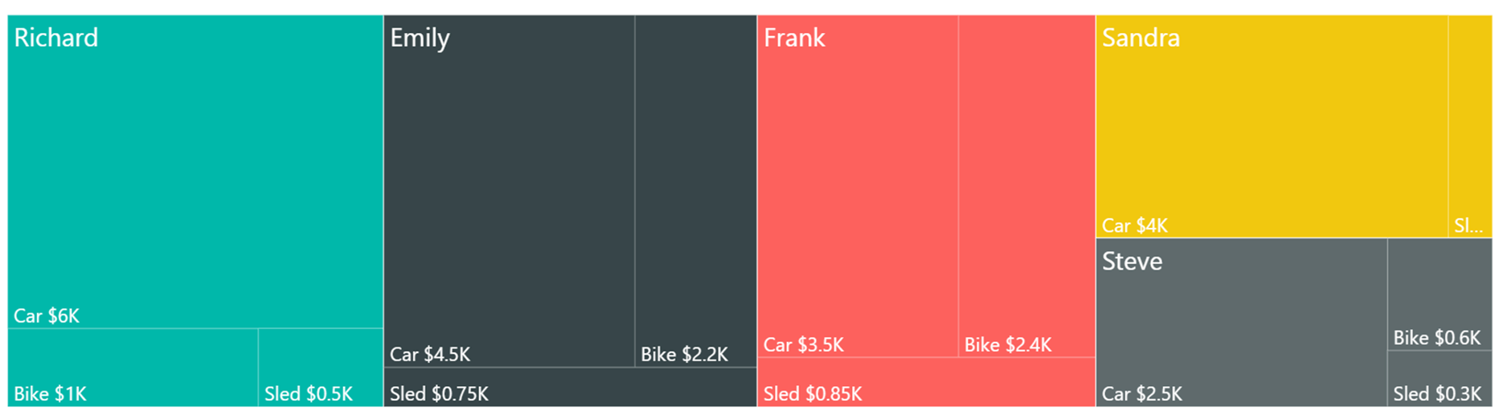
TREEMAPS
Simultaneously show big picture and comparisons easily.
Easy to process data sub-categories.
Useful to prioritize “big ticket items” in dynamic dashboards.
Labeling and colouring are tricky.

Slide 43
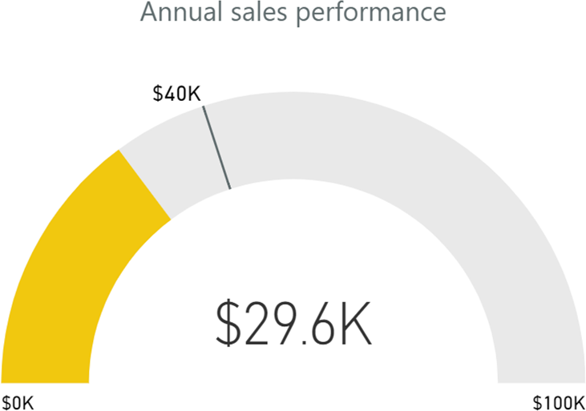
GAUGE CHARTS
Often used as a dashboard component (with or without needle).
Display single value measures towards goal / KPI.
Great to show progress (a bit of a management fad, though…)
Displays information that can be quickly scanned and understood.

Slide 44
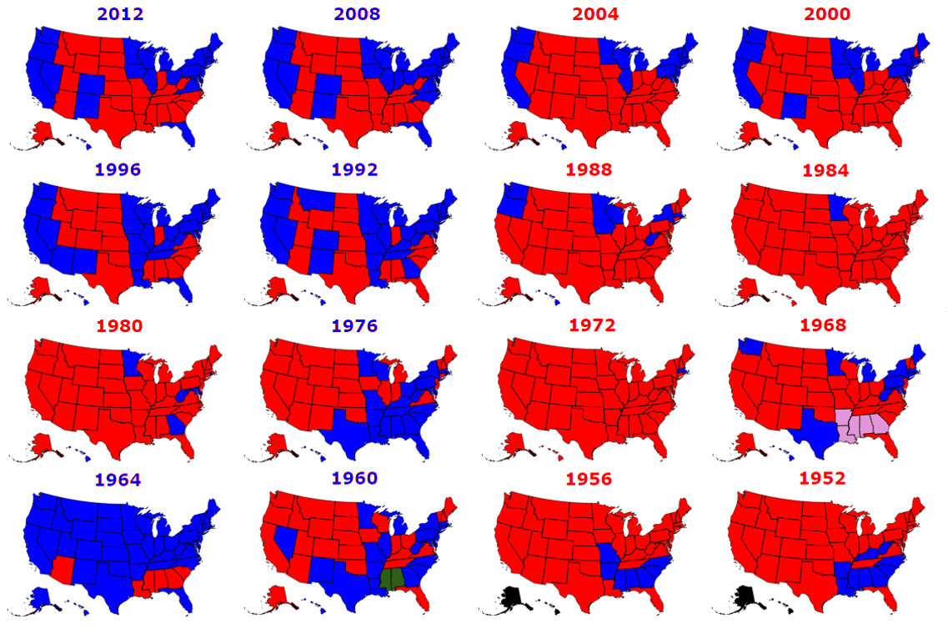
SMALL MULTIPLES
[Metrocosm.com]
U.S. Electoral College Results 1952 – 2012

Slide 45
OTHER CHART TYPES
Heatmaps and Choropleth Maps
Geographical Maps
Parallel Coordinates
Chernoff Faces
Word Clouds
Network Diagrams
Dendrograms and Trees
Sparklines
etc.

Slide 46
INTERACTIVE AND ANIMATED VISUALIZATIONS
Animation does not always improve a visualization. What insights can interactivity provide? That depends on the data, and on the visualization method.
Examples:
The Clubs That Connect the World Cup, NY Times, 2014
Who Marries Whom, Bloomberg, 2016
Hipparcos Star Mapper, European Space Agency, 2016
The Internet of Things – a Primer, Information is Beautiful, 2016
The Genealogy and History of Popular Music Genres, Musicmap, 2016
Notes:
https://en.wikipedia.org/wiki/Interactive_data_visualization
http://earthobservatory.nasa.gov/blogs/elegantfigures/2013/03/14/is-animation-an-effective-tool-for-data-visualization/

Slide 47
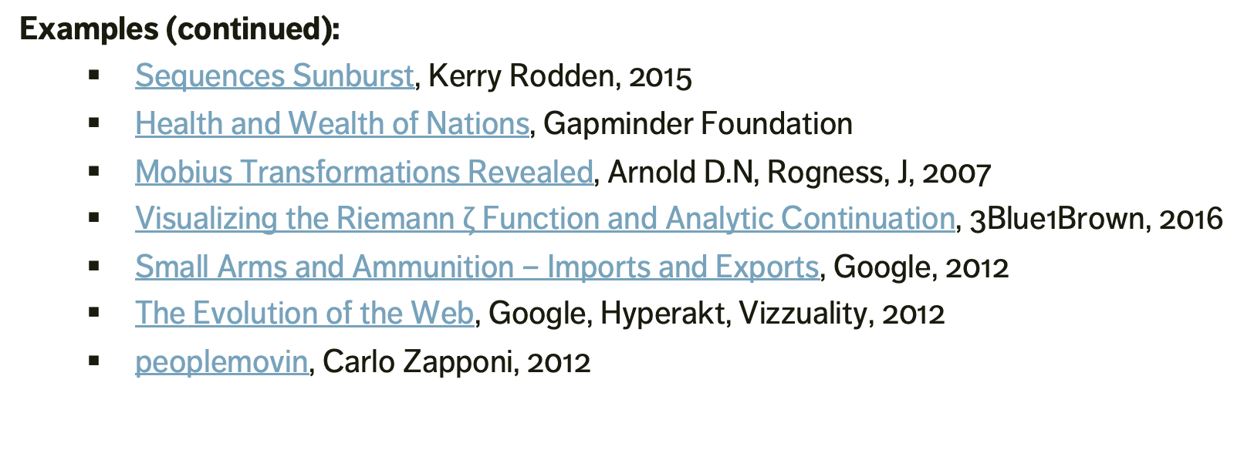
INTERACTIVE AND ANIMATED VISUALIZATIONS
Examples (continued):
Sequences Sunburst, Kerry Rodden, 2015
Health and Wealth of Nations, Gapminder Foundation
Mobius Transformations Revealed, Arnold D.N, Rogness, J, 2007
Visualizing the Riemann $ζ$ Function and Analytic Continuation, 3Blue1Brown, 2016
Small Arms and Ammunition – Imports and Exports, Google, 2012
The Evolution of the Web, Google, Hyperakt, Vizzuality, 2012
peoplemovin, Carlo Zapponi, 2012
Notes:
https://en.wikipedia.org/wiki/Interactive_data_visualization
http://earthobservatory.nasa.gov/blogs/elegantfigures/2013/03/14/is-animation-an-effective-tool-for-data-visualization/

Slide 48
DISCUSSION
“There is always a danger that if certain types of visualization techniques take over, the kinds of questions that are particularly well-suited to providing data for these techniques will come to dominate the landscape, which will then affect data collection techniques, data availability, future interest, and so forth.” (P. Boily)
Even when done well, 85% of users don’t bother with interactive viz (NY Times).
Take-Away: explore the data and try different methods
Notes:
There is always a danger that if certain types of visualization techniques take over, the kinds of questions that are particularly well-suited to providing data for these techniques will come to dominate the landscape, which will then affect data collection techniques, data availability, future interest, and so forth.

Slide 49
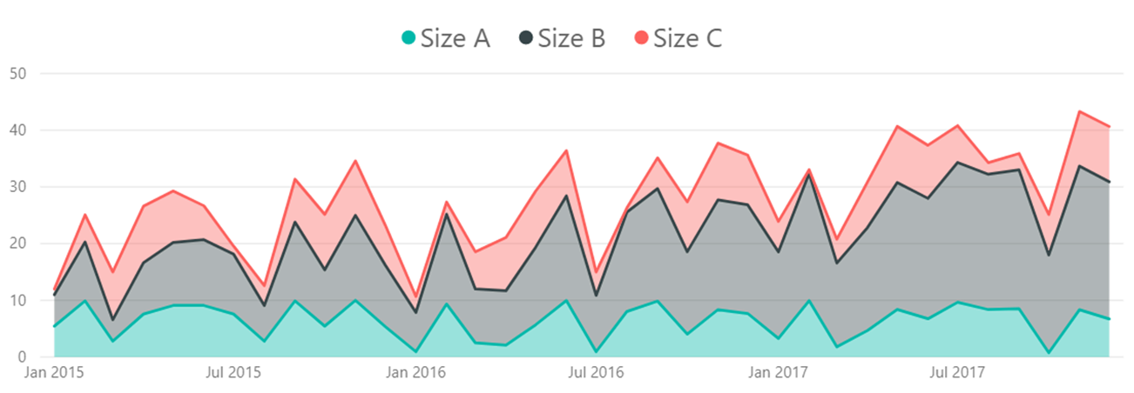
CHARTS TO AVOID (within reason)
AVOID (?) anything with an arc (except gauge charts): pie, donut, etc: human brains have a hard time comparing arcs -- without labels, how different are Steve & Bob?
AVOID 3D charts: it is difficult to compare them visually (and they add too much clutter).
AVOID stacked area charts: way too confusing.

Slide 50
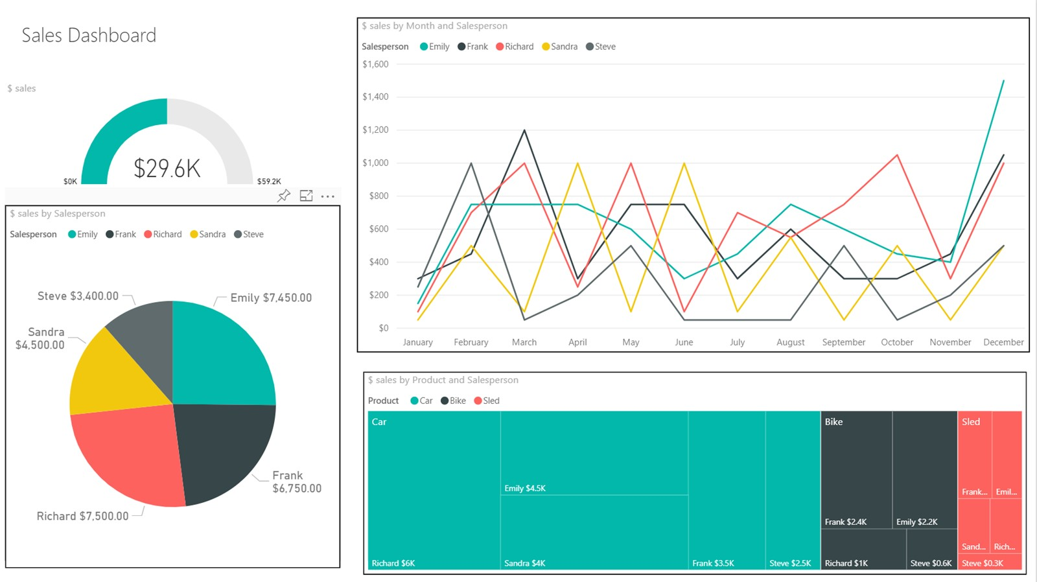

Slide 51
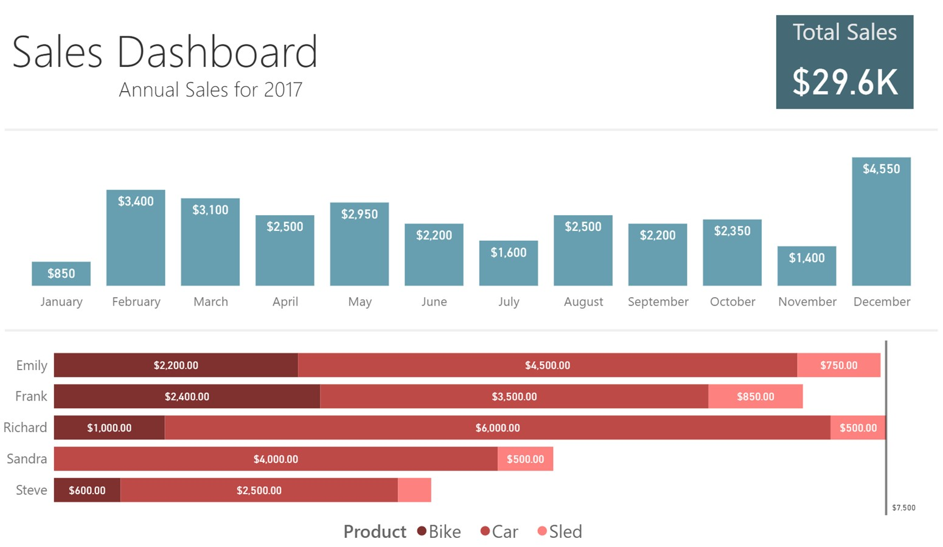

Slide 52
TAKE-AWAYS
Effective data visualizations provide insights and facilitate understanding.
The basic principles can guide your visualization design and consumption.
Be creative but keep your data and your representations honest.
Be mindful of attempts to distort trends and conclusions with flashy visuals.
Data and code should be made available along with the displays.

Slide 53
BASIC RULES OF DESIGN AND LAYOUT
DATA VISUALIZATION BASICS

Slide 54
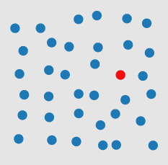
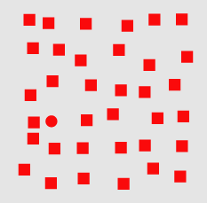
VISUAL PROCESSING
pre-attentive
Perception is fragmented – eyes are continuously scanning.
Visual thinking seeks patterns
Pre-attentive processes: fast, instinctive, efficient, multitasking gather information and build patterns:
features → patterns → objects
Attentive process: slow, deliberate, focused discover features in the patterns:
objects → patterns → features
attentive
Notes:
Pre-attentive processes

Slide 55
PRE-ATTENTIVE ATTRIBUTES
Pre-attentive attributes are the domain of iconic memory (brief): they
help to define a hierarchy of focus
push non-message impacting components into the background
Use pre-attentive attributes to help emphasize the story (but don’t overdo them):
easier to do in Excel and R, harder in Power BI
Challenge: highlighting one aspect of a chart can make other aspects harder to see.

Slide 56
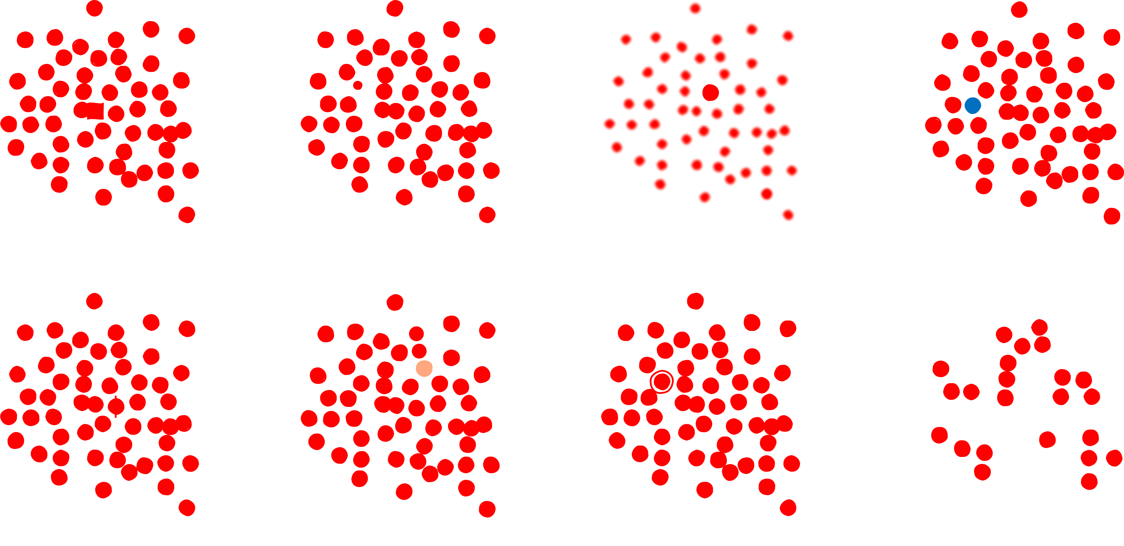
PRE-ATTENTIVE FEATURES
[P. Boily, S. Davies, J. Schellinck, The Practice of Data Visualization]
shape
size
sharpness
color/hue
markings
intensity/value
enclosure
numerosity

Slide 57
PRE-ATTENTIVE ATTRIBUTES
[P. Boily, S. Davies, J. Schellinck, The Practice of Data Visualization]
How many 6’s are
there on the next slide?

Slide 58
[P. Boily, S. Davies, J. Schellinck, The Practice of Data Visualization]
2869408609876
9348586748676
2967303986739
3967496749674

Slide 59
[P. Boily, S. Davies, J. Schellinck, The Practice of Data Visualization]
2869408609876
9348586748676
2967303986739
3967496749674

Slide 60
[P. Boily, S. Davies, J. Schellinck, The Practice of Data Visualization]
2869408609876
9348586748676
2967303986739
3967496749674

Slide 61
[P. Boily, S. Davies, J. Schellinck, The Practice of Data Visualization]
2869408609876
9348586748676
2967303986739
3967496749674

Slide 62
[P. Boily, S. Davies, J. Schellinck, The Practice of Data Visualization]
2869408609876
9348586748676
2967303986739
3967496749674

Slide 63
[P. Boily, S. Davies, J. Schellinck, The Practice of Data Visualization]
2869408609876
9348586748676
2967303986739
3967496749674

Slide 64
DECLUTTERING (or, Less is More)
CLUTTER IS THE ENEMY!
every element on a page adds cognitive load
identify anything that isn’t adding value and remove
think of cognitive load as mental effort required to process information (lower is better)
Tufte refers to the data to ink ratio – “the larger the share of a graphic’s ink devoted to data, the better”
in Resonate, Duarte refers to this as “maximizing the signal-to-noise ratio” where the signal is the information or the story we want to communicate.

Slide 65
DECLUTTERING (or, Less is More)
Use Gestalt Principles to organize/highlight data in a chart.
Align all the elements (graphs, text, lines, titles, etc.)
DON’T rely on eye, use position boxes and values
Charts:
remove border, gridlines, data markers
clean up axis labels
label data directly
Things
More things

Slide 66
DECLUTTERING (or, Less is More)
Use consistent font, font size, colour and alignment.
Don’t rotate text to anything other than 0 or 90 degrees.
Use white space:
margins should remain free of text and visuals
don’t stretch visuals to edge of page or too close to other visuals
think of white space as a border

Slide 67
CHART SIZES
Assuming that the chart has been decluttered:
things of equal importance size similarly;
other things scale to importance.
As one rarely puts more than 3-4 charts on a page, there are limited size options.
Perennial exception: geographical maps may require more space.

Slide 68

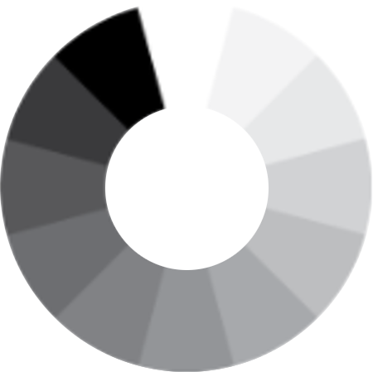
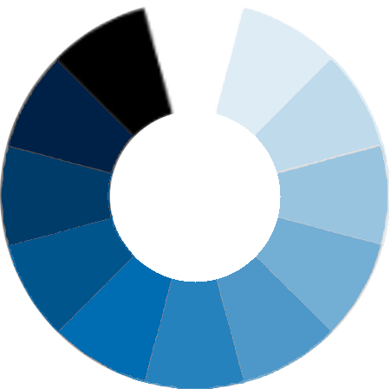
COLOUR SCHEMES
[http://www.deanenettles.com/webexamples/colorexamples]
Split-Left/Right Complementary
Analogous
Colour Diad
Colour Triad
Colour Tetrad
Achromatic
Monochromatic
Complementary
Split complementary

Slide 69
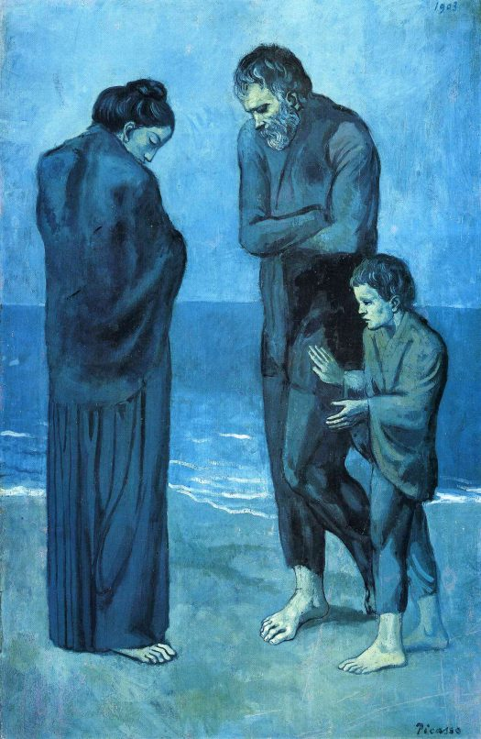

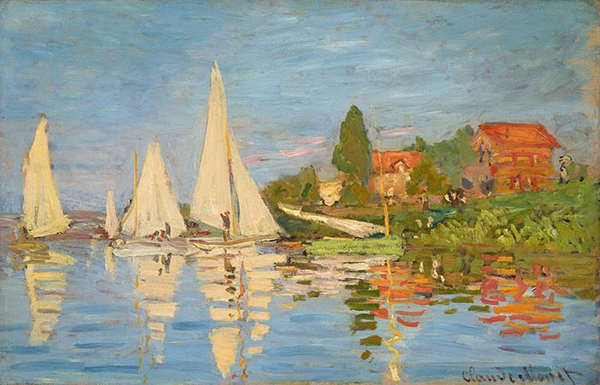









Can you identify the colour schemes underlying each of these images?

Slide 70
Split Complementary (Green, Orange & Blue)
Achromatic
Monochromatic (Blues)
Tetrad
Diad (Blue & Green)
Triad (Primary Colors)
Diad (Green & Orange)
Analogous (Green & Yellow)
Complementary
Can you identify the colour schemes underlying each of these images?
Diad (Red &Violet)

Slide 72
COLOUR SCHEMES
When it comes to colour, less is more: use it sparingly (graphic designers are taught to “get it right, in black and white”).
Based on the Gestalt Principles, monochrome schemes can be particularly effective.
When appropriate, pick scheme based on corporate identity (this maximizes buy in).
Create a template (and stick to it).
Upload images to see what charts look like in various flavours of colour-blindness:
https://www.color-blindness.com/coblis-color-blindness-simulator (there are other tools)

Slide 73
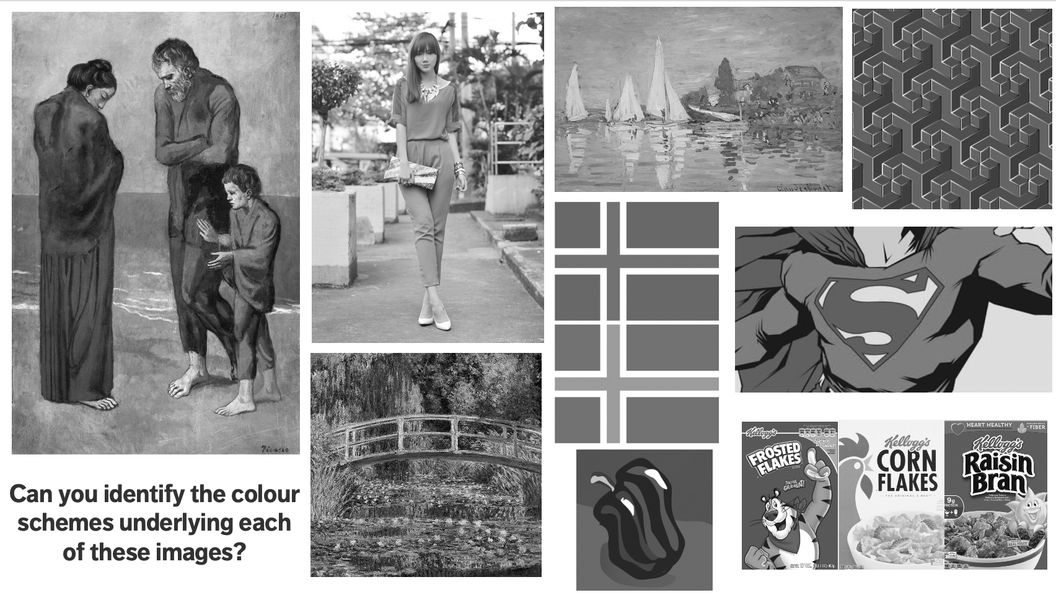
Monochromatic
achromatopsia (greys)

Slide 74
POSITION
How should the elements be placed in a chart or a dashboard?
In the West, most people start at the top left and zig- zag all the way to the bottom right.
Simple rule: don’t make people work too hard
main message: top left/top right
info in order of preference
people concentrate less as they scan so get less complex as you move to bottom corner
1
2
3
4

Slide 75
DASHBOARDS
DATA VISUALIZATION BASICS

Slide 76
DASHBOARDS
[Wexler, Shaffer, Cotgreave, The Big Book of Dashboards]
A dashboard is any visual display of data used to monitor conditions and/or facilitate understanding.
Examples:
interactive display that allows people to explore motor insurance claims by city, province, driver age, etc.
PDF showing key audit metrics that gets e-mailed to a Department’s DG on a weekly basis.
wall-mounted screen that shows call centre statistics in real-time.
mobile app that allow hospital administrators to review wait times on an hourly- and daily-basis for the current year and the previous year.

Slide 77
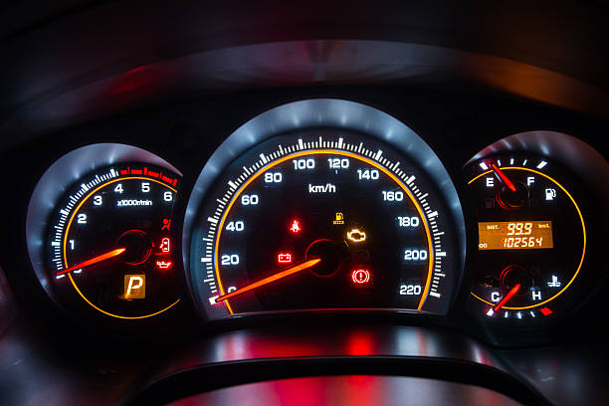
SOME QUESTIONS TO PONDER
In a car’s dashboard, a small number of key indicators (speed, gasoline level, lights, etc.) need to be understood at a glance. A dashboard design that does not take these two characteristics under consideration can have catastrophic consequences.
The following questions need to be answered prior to the dashboard being designed:
Who is the dashboard’s consumer?
What story does the dashboard tell?
What data (categories) will be used?
What will appear on the dashboard?
How can the dashboard help the consumer?

Slide 78
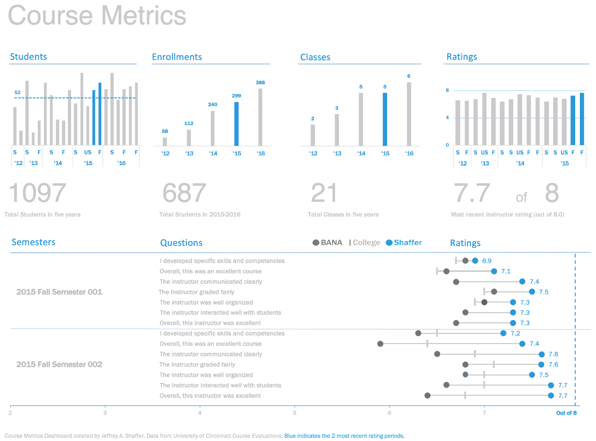
[https://bigbookofdashboards.com/dashboards.html]
Strengths:
Easy-to-see key metrics
Simple color scheme
Potential to be static or interactive
Both overview and details are clear
Notes:
https://bigbookofdashboards.com/dashboards.html

Slide 79
DASHBOARD EVALUATION
There are no perfect dashboards – no collection of charts will ever suit everyone who encounters it.
All dashboards should be truthful and functional, but dashboards that are also elegant (delightful, enjoyable) will take you further.
All dashboards are incomplete. Good dashboards will still lead to dead ends, but they should allow users to ask: “Why? What is the root cause of a problem?”
Tools: Excel, Power BI, Tableau, R + Shiny, Geckoboard, Matillion, etc.

Slide 80
EXERCISE
Consider the following dashboards.
Can you figure out, at a glance, who their audience is?
What are their strengths?
What are their limitations?
How would you improve them?

Slide 81
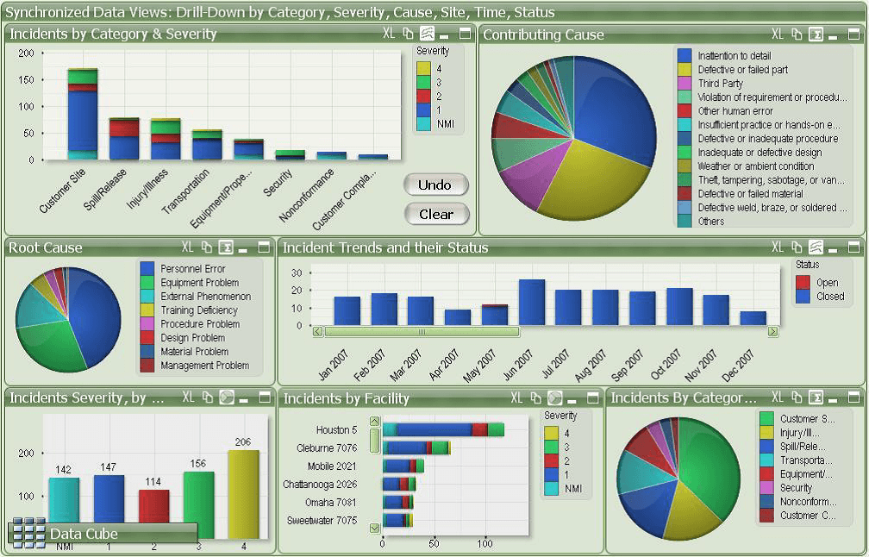
[https://www.matillion.com/wp-content/uploads/2014/11/qlikview-poor-use-of-dashboard-software.png]
Notes:
https://bigbookofdashboards.com/dashboards.html

Slide 82
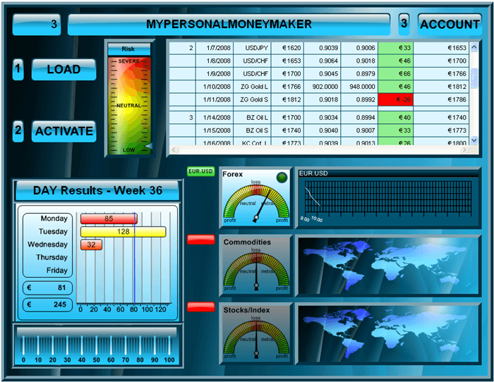
[https://www.geckoboard.com/assets/2-terrible-dashboard-example-min.png]
Notes:
https://bigbookofdashboards.com/dashboards.html

Slide 83
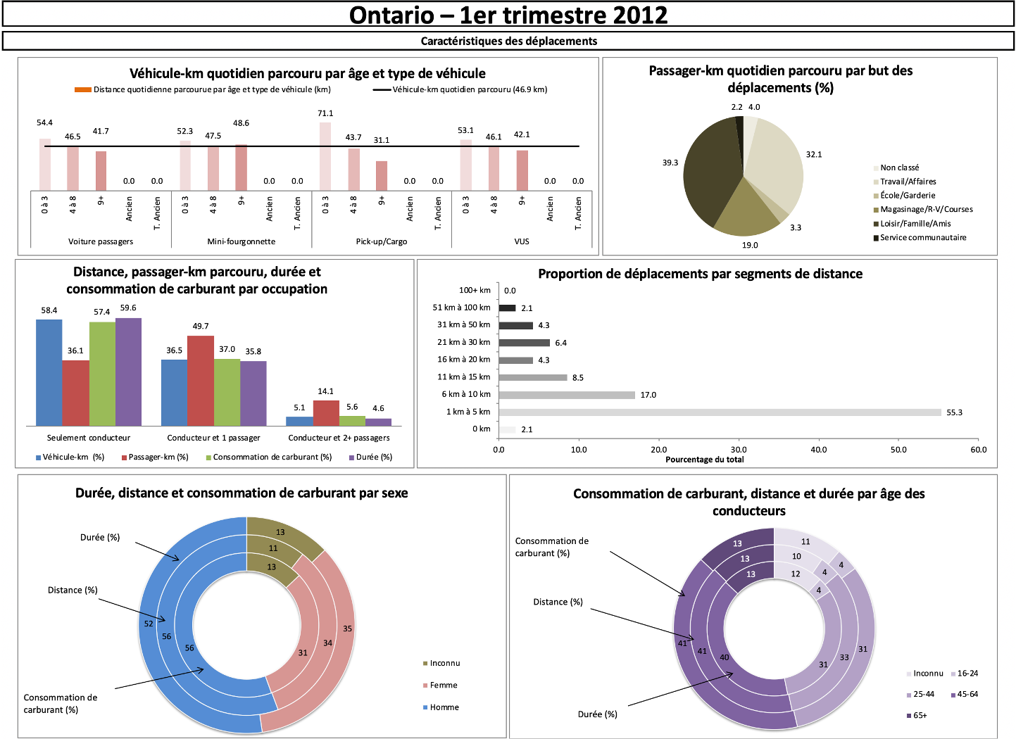
[Personal file]
Notes:
https://bigbookofdashboards.com/dashboards.html

Slide 84
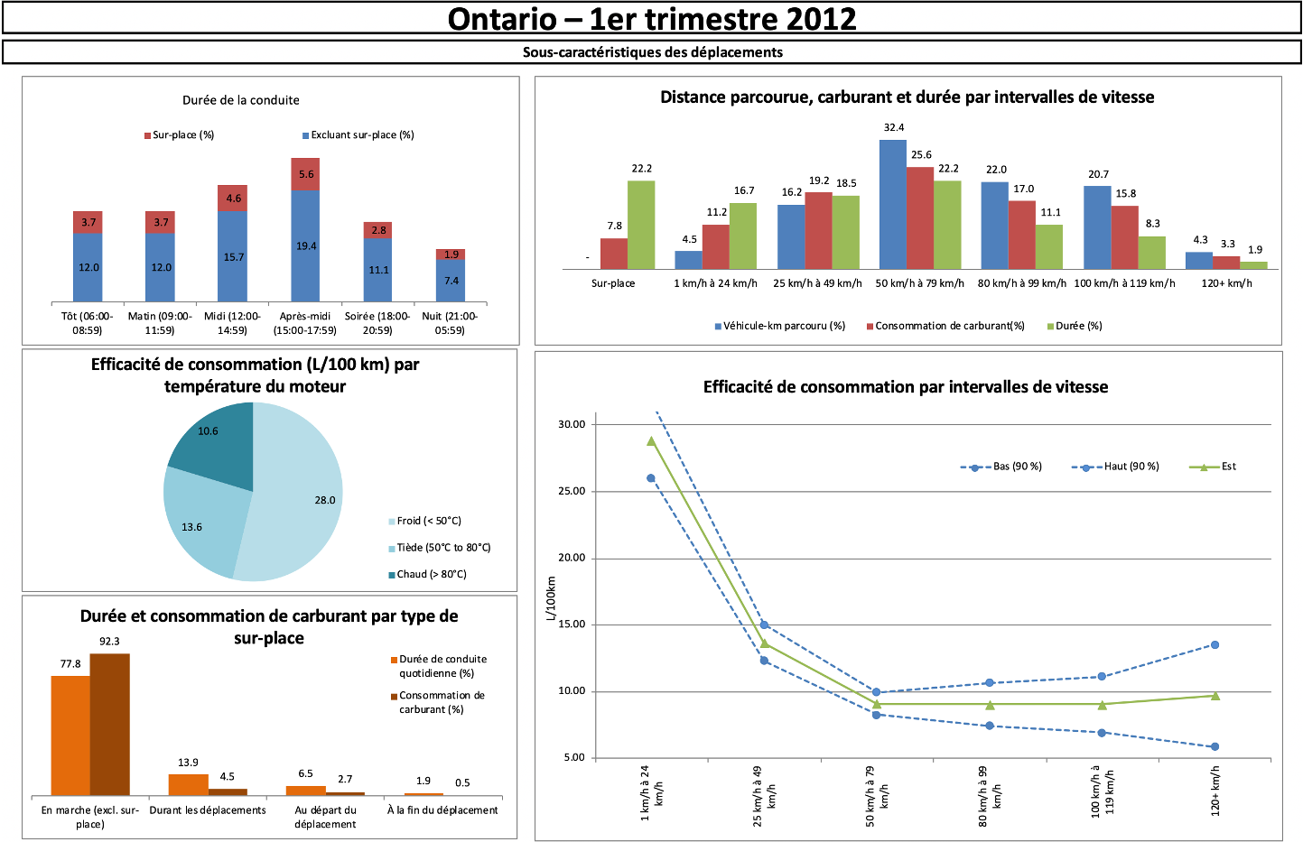
Notes:
https://bigbookofdashboards.com/dashboards.html

Slide 85
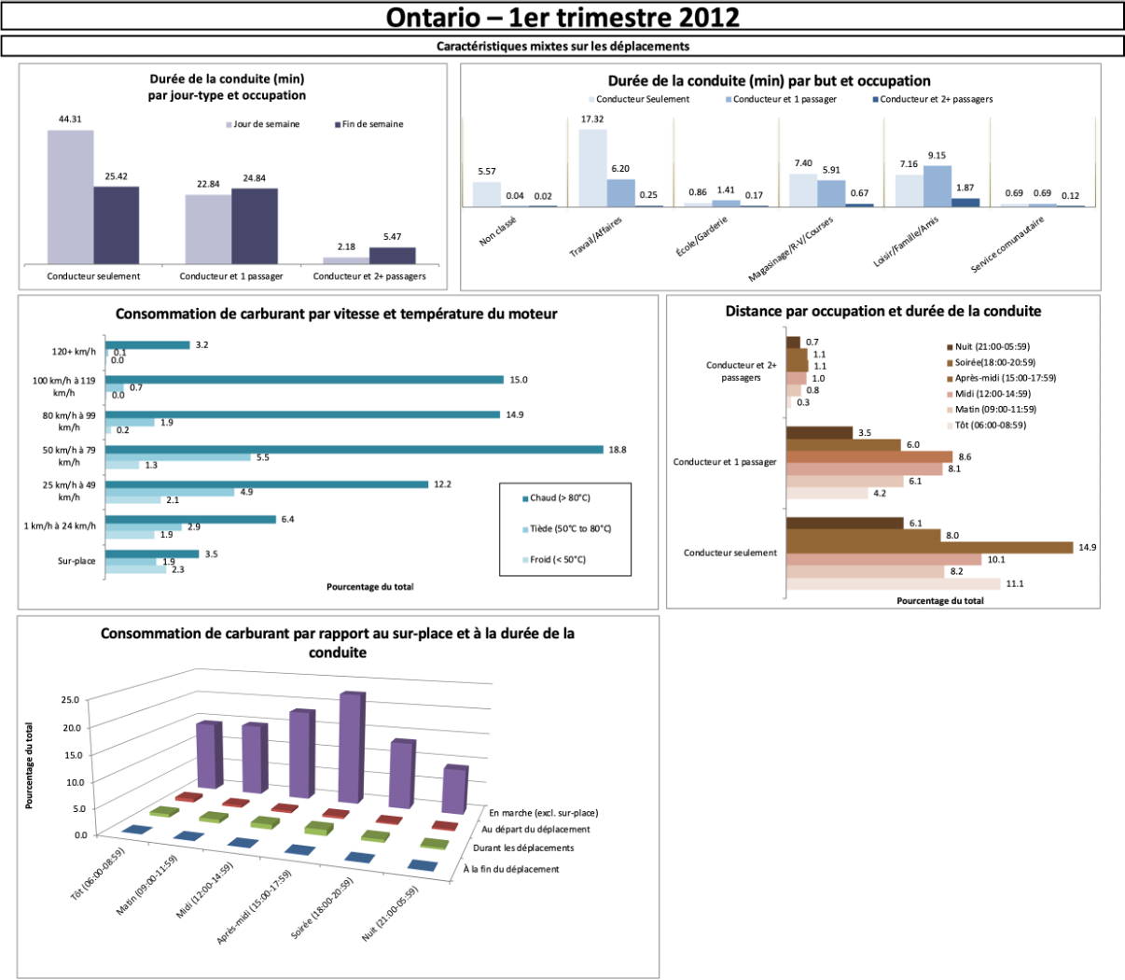
[Personal file]
Notes:
https://bigbookofdashboards.com/dashboards.html

Slide 86
WHAT IS WRONG WITH THEM?
Dashboard #1: not glanceable, overuse of colour, pie charts, …
Dashboard #2: 3D visualizations, distracting borders and background, lack of filtered data, insufficient labels and context, …
Dashboards #3: where to begin …

Slide 87
EXERCISE
In teams or individually, identify a scenario for which a dashboard could prove useful.
Determine specific questions that the dashboard could help answer or insights that it could provide.
Identify data sources and data elements that could be fed into your dashboard.
Design a display (with pen and paper) with mock charts.
What are the strengths and limitations of your dashboard? Is it functional? Elegant?

